Slide 1
Name | Cameron
Git Hash | f0cc35dd3a8cfb1d7bee623bf8f55deddab5ad80
Sprint number | Start date | end date | Work hard rating
 | 27/6/2022 | 8/7/2022 | 4/5

Slide 2
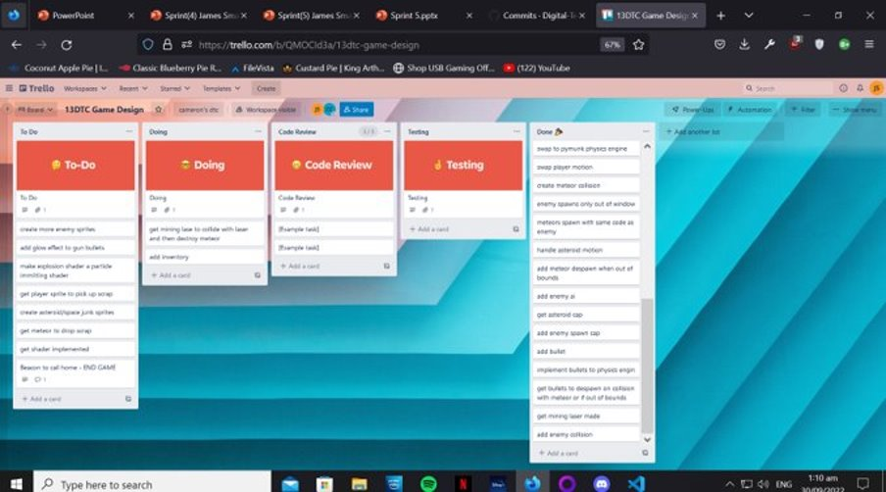
KANBAN board at the start of the sprint

Slide 3
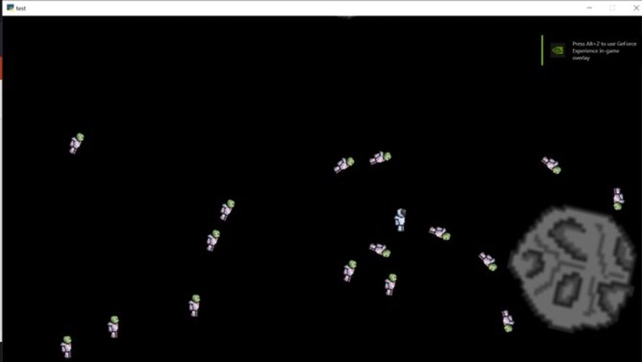
Screenshot of the game at the start of the sprint

Slide 4
Sprint Reflection and summary
I created an inventory view with an inventory grid but i couldnt understand GUI so i had to learn how GUI works
I also did some fixes for AI
GUI will take me a long time to understand but i think i can work out how it works

Slide 5
Briefly describe other team members contributions
James made the bullets kill the enemies
He also made the laser kill meteors and they dropped resources
He created a function which will randomly choose 1 of 3 different resources to be dropped

Slide 6
Major Changes and Achievements Described
Resources are dropped from meteors which can be picked up but it is not shown or used anywhere
An inventory grid is created and it can be accessed by pressing E
Ai will flee asteroids

Slide 7
Brief Description of your testing
The inventory testing was mostly checking to see if the grid looked nice due to me not how GUI works
We killed meteors and picked up drops to test meteor kill and drop collection. This meant we could tweak health and fix bugs

Slide 8
Link to testing results/tables

Slide 9
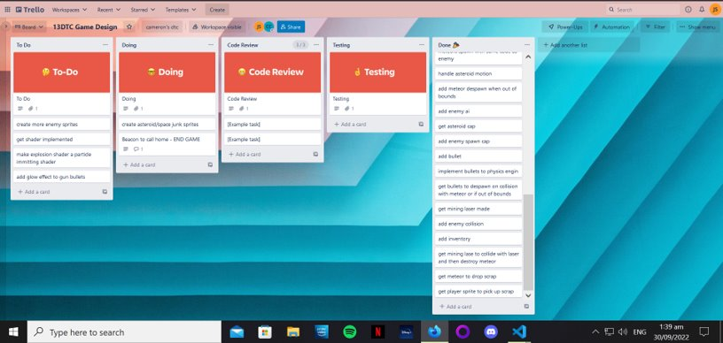
KANBAN board at the end of the sprint

Slide 10
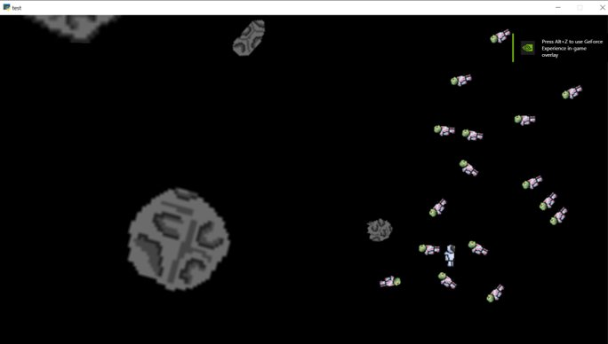
Screenshot of the game at the end of the sprint

Slide 11
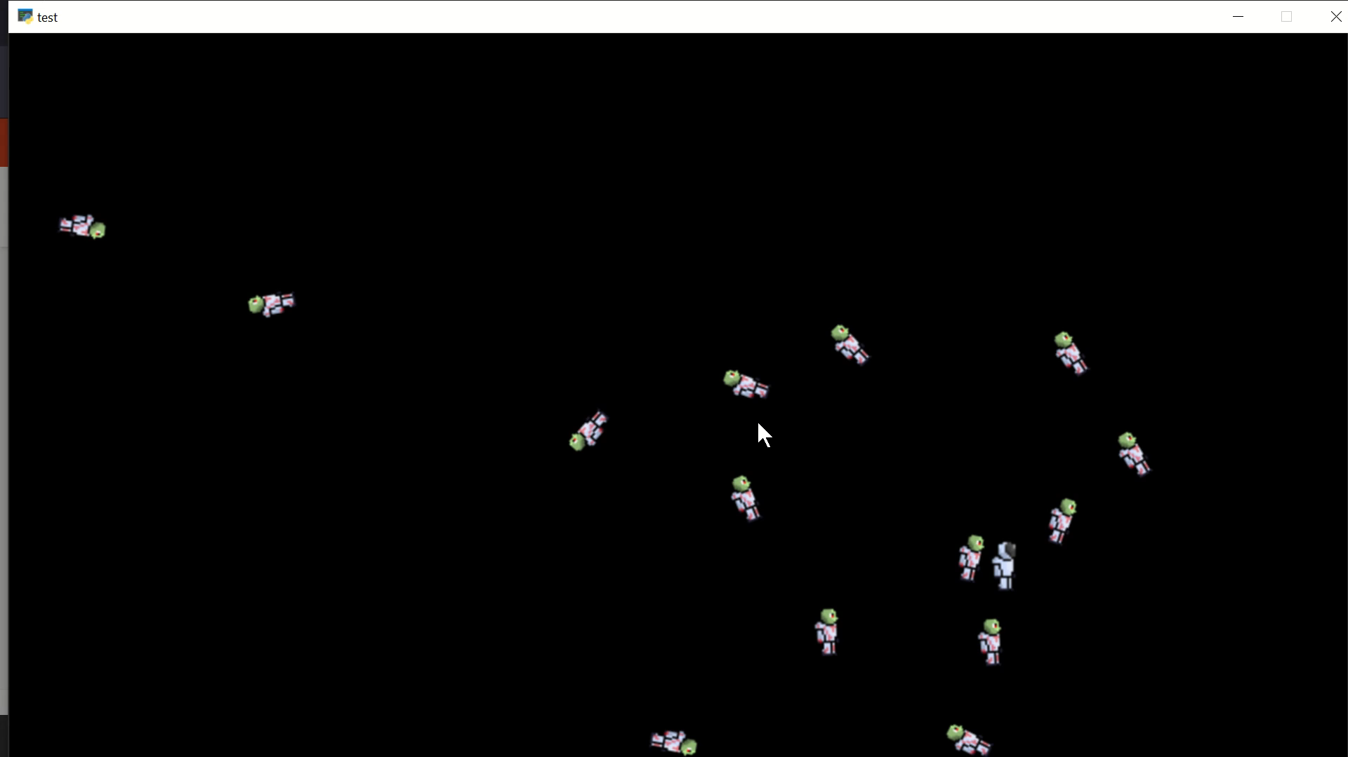
Video of the game at the end of the sprint

Slide 12
Notes for next time, future improvements
I need to finish inventory
James is working on shaders which may be very difficult and need a lot of learning

